Slide 1

MOLECULAR REBAR®
For Use in Micro-Hybrid Automotive and 2-Wheel VRLA Automotive
Dr. Pedro Britto and Carlos Perez
Black Diamond Structures, Austin TX USA

Slide 2

Who We Are
Black Diamond Structures is a developer, manufacturer, and marketer of innovative nanomaterial products and solutions based on revolutionary carbon nanotube (CNT) technology, MOLECULAR REBAR®
Our Partners
Notes:
“soul of a start up with the resources of a multinational corporation”

Slide 3
MOLECULAR REBAR® Technology
Key Technical Advantage
Bulk
Carbon Nanotubes
Customer Integration w/ End-Product
Detangling/ Separation
Formulation - Dispersion
Master
Batch - Concentrate
Clumps of Dirty, Entangled CNT’s
MR in Lead Paste
(or other substrates)
Clean, Detangled MR Discrete, Individual Tubes
Notes:
MR is, again, a novel derivative of CNT, produced by MRD.
MRDs competitive advantage is our patented 3 step process…
An artifacts of the scale up process
Woolen balls
No theoretical properties
Donate those theoretical properties back
ONLY when discrete, ONLY when packaged appropriately
MENTION = high impurity rates, EH+S concerns, data generated is similar to carbon, similar size to carbon
Mechanical or Structural improvements to Materials (melting points < 500C
Tear, impact, toughness and crack improvements (dramatic)
Reduced co-efficient of expansion and contraction (dramatic)
Improved adhesion and other surface phenomena (dramatic)
Strength and modulus combinations with above
Transport properties
Heat and electrical
Ion and molecular transport
Electromagnetic fields effects
Absorptions and reflection that can be controlled
Fields affect MR and MR affects field
Fabrication of unique structures due to size and viscosity
Thin
MR oriented randomly, in transverse plane and planar
Multi-layers to take advantage of surface properties

Slide 4
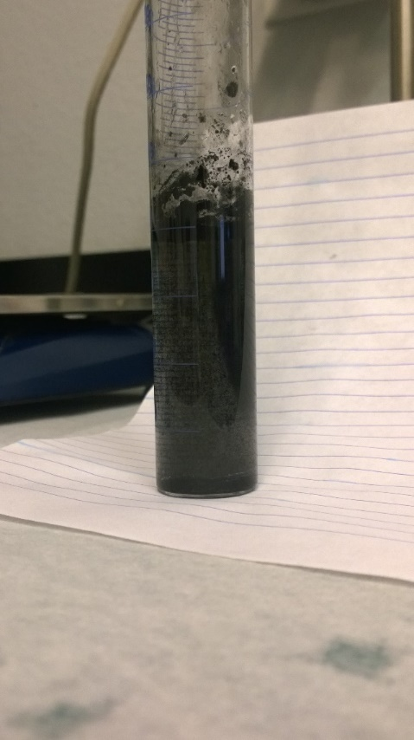
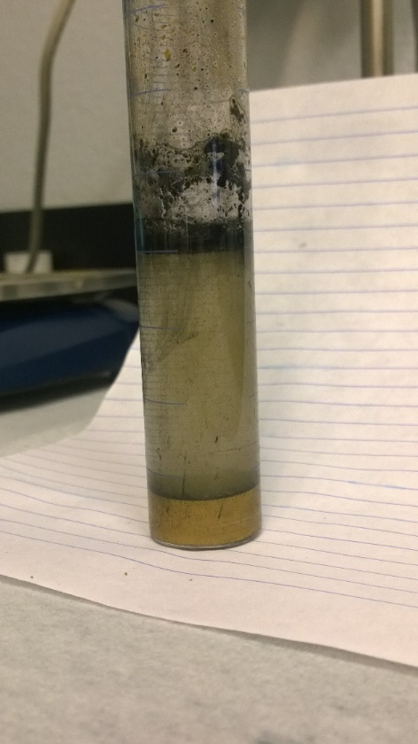
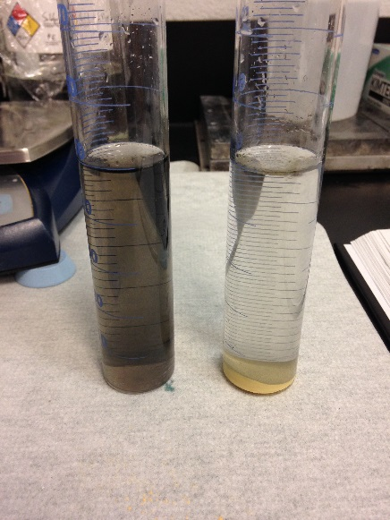
Superior Incorporation in H2O/Acid, PbO
MOLECULAR REBAR® uniformly mixes with water and acid in battery paste.
  Advanced Carbons do not
MR is strongly attracted to the lead as automotive-grade lead oxide is added to mixtures of MR and water or acid
  Advanced Carbons are not
MR has most efficient interaction with lead, water, and acid vs competitive carbon offerings
  MR is a competitive advantage for battery makers
Floating
Carbon (70%)
Floating Carbon
(70%)
+ 10 g PbO
Advanced Carbon
Carbon in Flux
(Moving ↑/↓)
(20%)
Carbon in Flux
(Moving ↑/↓)
20%
Sunken Carbon
(10%)
Carbon (10%)
Lead
Homogenous
Mixture
100%
+ 10 g PbO
Molecular Rebar®
Cleared
Acid
Lead/MR
(100%)

Slide 5
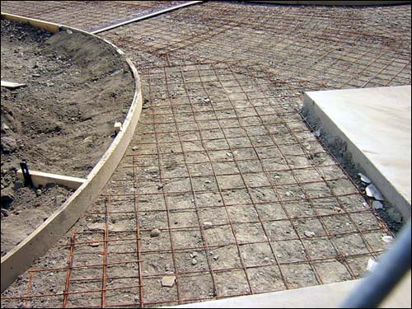
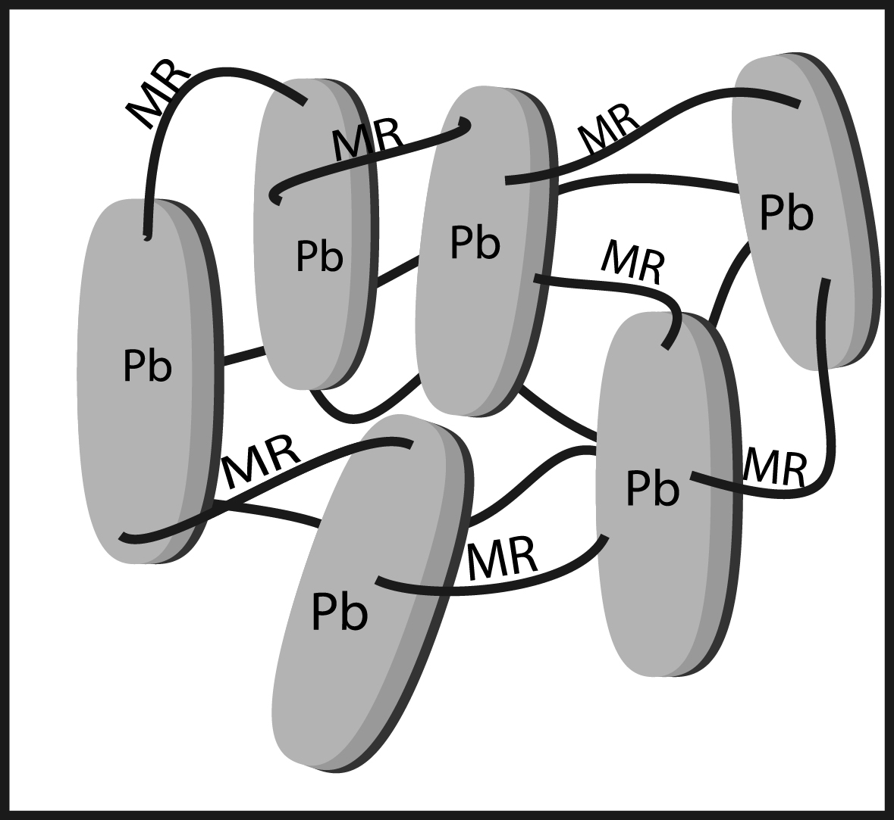
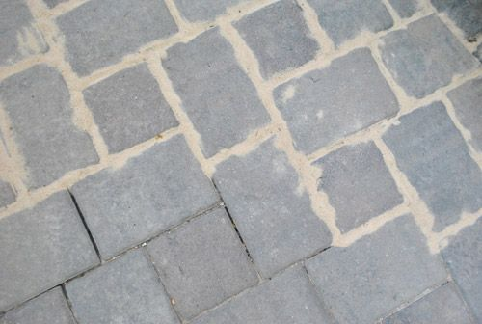
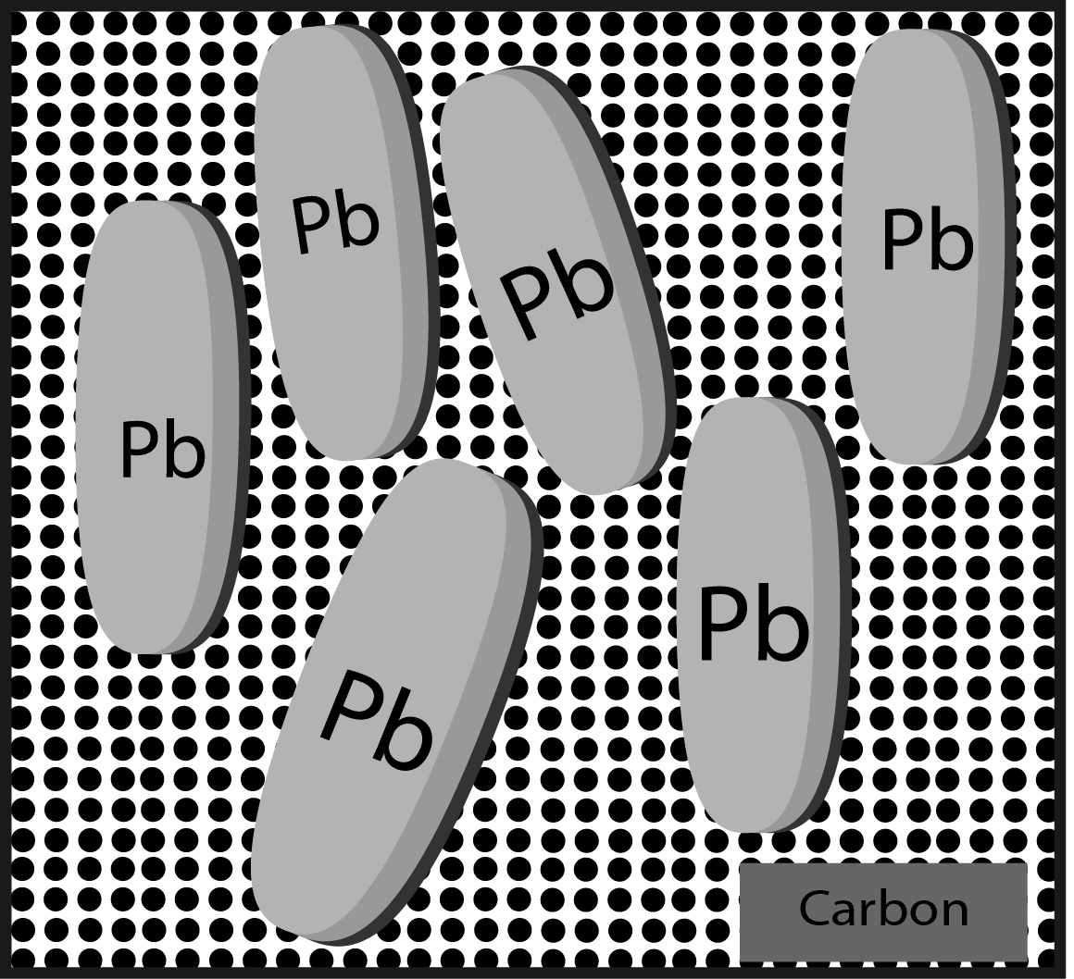
Not Another Carbon

Slide 6
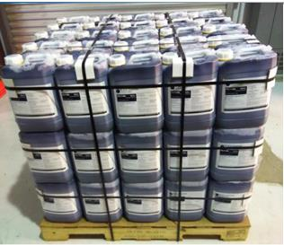
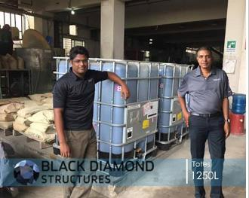
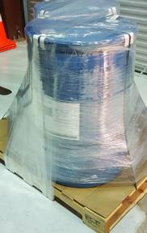
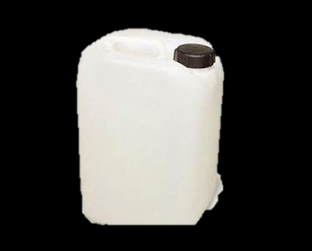
About us: Product & Packaging
Material is shipped as a black pourable liquid which is added directly to the paste mixer for both NEGATIVE & POSITIVE plates
MOLECULAR REBAR® products are formulated for ease of use and incorporation
Sold in 1,250L Totes, 200L Drums or 10L Jugs.
9 Month Shelf life
A volume of pasting water is replaced with the MOLECULAR REBAR® liquid so total liquid volume remains the same
10L Jug
Pb2100N
Paste Mixer

Slide 7
About us : Products (by Application)
Application |  | NAM Product | PAM Product
Automotive | SLI & Heavy Truck – Conventional Flooded | Pb1100N | Pb1100P
 | Start/Stop – Enhanced Flooded | Pb1200N | Pb1200P
 | Advanced Auto - VRLA | Pb1300Nx | Pb1300Px
 | Motorcycle – VRLA | Pb1400N | Pb1400P
Motive Power | eRickshaw - Flooded (Tubular) | Pb2100N
 | eRickshaw - Flooded (Flat Plate) | Pb2200N
 | eVehicles - VRLA | Pb2300N | Pb2300P
 | Lift Trucks – Flooded | Pb4100Nx | Pb4100Px
Stationary | Inverter - Flooded | Pb3100N
 | Solar - Flooded | Pb3200N
 | Solar (PSOC)- VRLA | Pb3300N | Pb3300P
 | Advanced Renewables & Utilities - VRLA | Pb3400Nx | Pb3400Px
 | Telecom - VRLA | Pb3500Nx | Pb3500Px
Commercial Product / Active Validation

Slide 8
Global Adoption - MOLECULAR REBAR® Technology
Global Adoption:
  Products Commercially Available and being sold to Lead Acid Battery Manufacturers across multiple end-use applications
  Working with >120 battery manufacturers worldwide, each at various stages of development and/or commercial sales.
  Recent approval for use in major Automotive OEM batteries. (SLI)
  Have proven that Molecular Rebar can help battery manufacturers meet new OEM requirements for “Advanced Automotive Battery” applications.
  Extremely large amount of data on full-scale production batteries.
  Invited to and participating in the CENELEC technical work group (Major Auto OEM’s, large battery MFR’s, limited supplier involvement).
  Approved to discuss three Mfr’s publicly at this time (Eastman – India, Pacific Battery – Fiji, Tianjin Lantian Power Sources – China)
Why the rapid adoption?
  Technology is innovative, cutting-edge, and scientifically sound
  Cost effective performance improvements over a wide variety of applications
  Low risk to use
  No (or very low) capital expenditure by manufacturer; very easy to use and implement
  Highly technical staff works hand in hand with your company during ramp up.
  World-class technical support from Black Diamond Structures

Slide 9
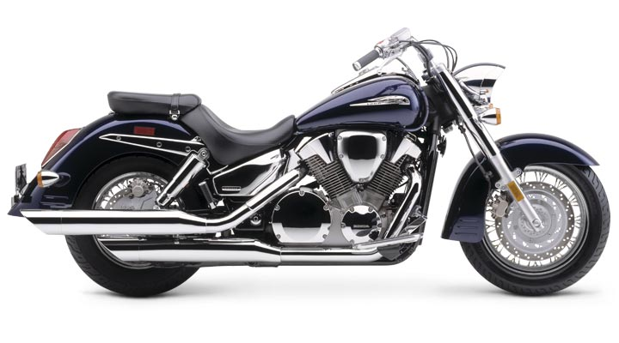
Motorcycle VRLA Batteries: Pb1400 Series
Products = Pb1410N & Pb1400P
Key Features:
  Used in Negative or Negative + Positive Electrodes
  No change to existing paste process or recipe
  Improved Consistency in Capacity + CCA Throughout Life
  Extended Cycle Life / Reduced Warranty Failures
  Increased Electrical Performance
  Enhanced Plate Strength / Durability
  Customer approved anonymous release 7Ah VRLA data included

Slide 10
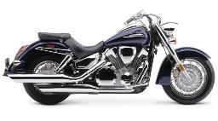
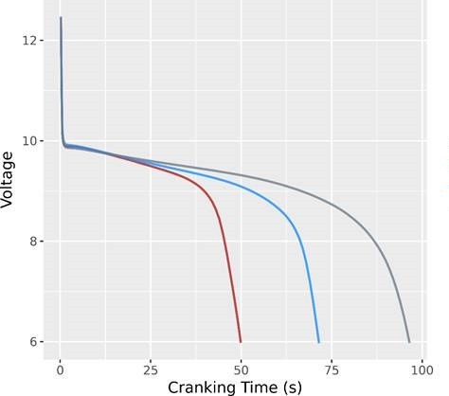
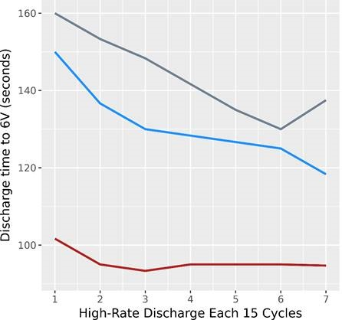
Motorcycle VRLA Batteries:
Pb1400 Series Products: Improved & Maintained Cold Cranking Amps
Molecular Rebar® provides higher CCA
Molecular Rebar® maintains higher CCA throughout life
Initial JIS D 5302: CCA Duration
50% DOD OEM Life Cycle Test @ 40⁰C
Control
10L Pb1410N
20L Pb1410N
Control
10L Pb1410N
20L Pb1410N
Pb1400 increases CCA Duration
50% increase with 10L of Pb1410N
100% increase with 20L of Pb1410N
1. Discharge for 2 hours @ 2.5X 10-hour rate (50% DOD)
2. Recharge @ 2.5X 10-hour rate with voltage limit of 14.4 V; 5 hours or minimum 108% charge return
-Repeat steps (1-2) 15X, Rest 24 hours, perform high-rate discharge at 40°C
-Repeat entire sequence for 6X, total of 90 cycles
Notes:
Need the 20L a different color so doesn’t get confused with NP

Slide 11
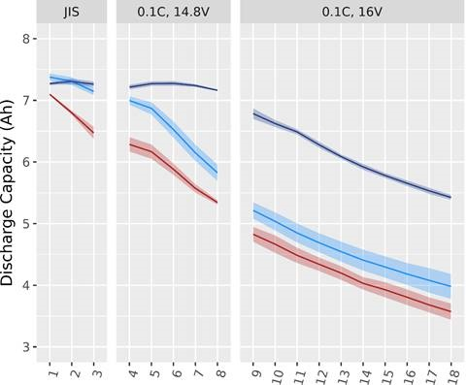
Motorcycle VRLA Batteries:
Pb1400 Series Products: Improves Capacity Retention & Recharge-ability
C10 Capacity Cycling Under Various Charging Protocols
MR maintains higher more consistent capacity under all charging protocols
Controls cannot recharge under standard JIS charging protocol:
MR enables the use of JIS charging in these batteries
Combination of Pb1410N & Pb1400P provides a more significant shift in capacity retention than Pb1410N alone
Control
Pb1410N
Pb1400P & Pb1410N

Slide 12
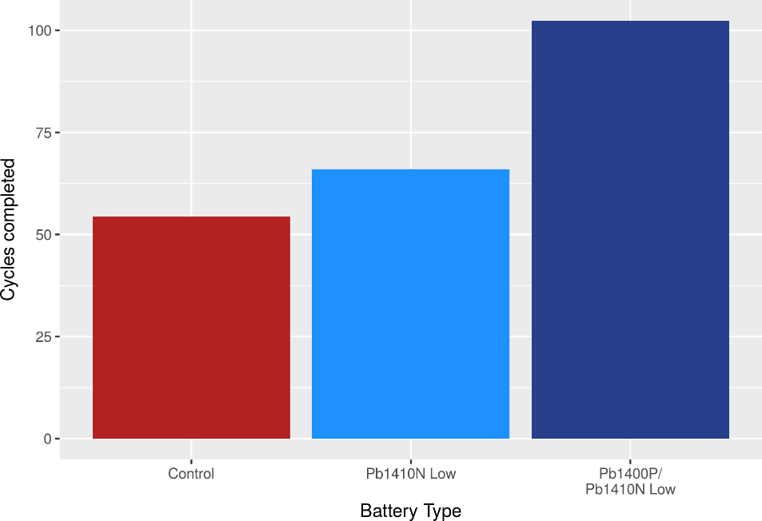
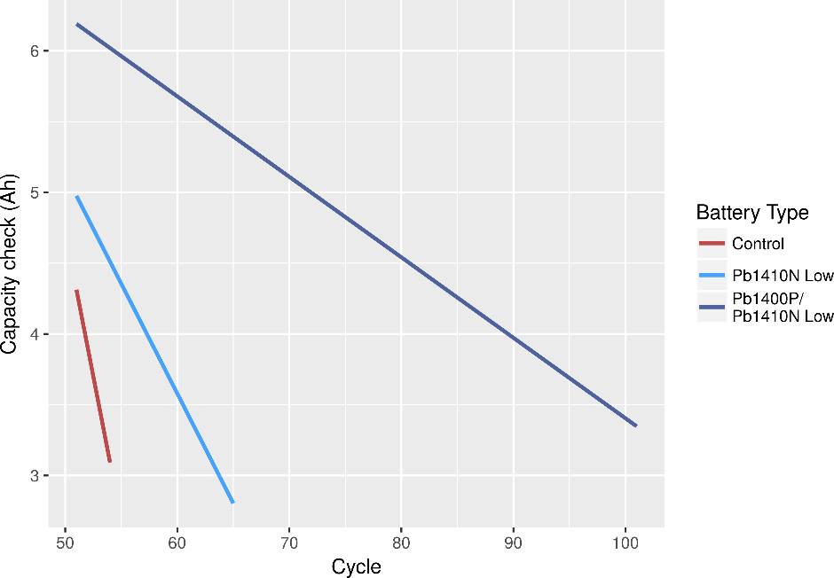
Motorcycle VRLA Batteries:
Pb1400 Series Products: Improves Cycle Life (JIS C 8702)
Molecular Rebar® extends cycle life by maintaining capacity
JIS C8702 Total Cycles
JIS C8702 C10 Capacity Check
90% Improvement
20% Improvement
Discharge at 1.9 A for 2 hours (~55% DOD)
Charge at 2.28 A and 14.1 V for 6 hours
Repeat 50x
C10 measured every 50 cycles or when voltage drops during cycling

Slide 13
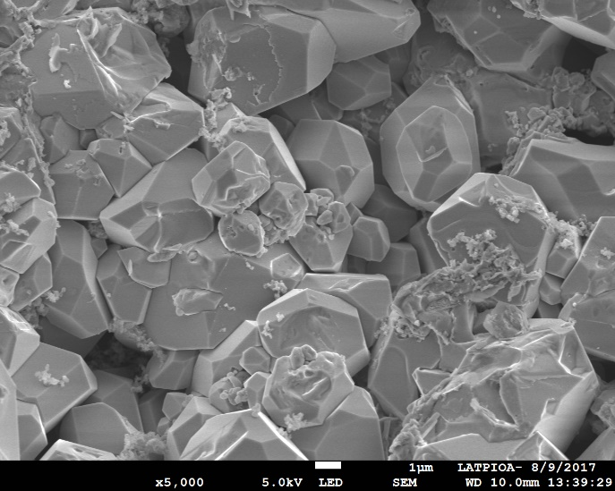
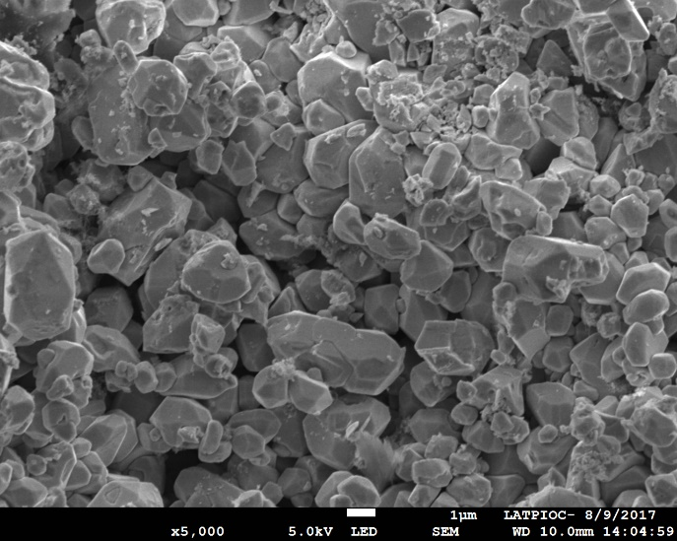
Motorcycle VRLA Batteries:
Pb1400 Series Products: Provides More Consistent Microstructure
SEM Imagery Post OEM Cycle Life Test
Control NAM
Pb1410N NAM
Control lacks uniformity and has significant crystal growth
Molecular Rebar® restricts growth and promotes uniformity

Slide 14
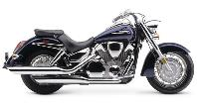
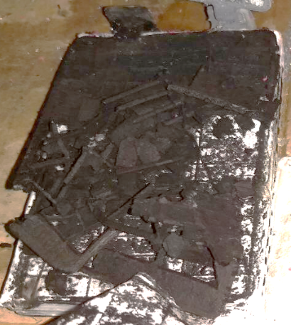
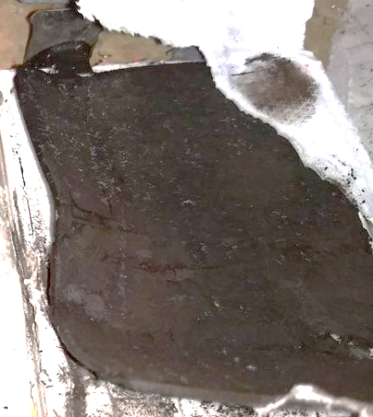
Pb1400 Series Motorcycle VRLA: Customer Testimonial #1
Post ABNT 15941 (similar to JIS D5302 Light Load):
  CONTROL failed HRD check @ 5,600 cycles
  Pb1400 never failed and were stopped @ 10,600 cycles
  C₁₀ post cycling was 4Ah for CONTROL and 5Ah for Pb1400
Customer produced 6Ah Motorcycle VRLA batteries using Pb1400 Series and found 2X Improvement in Cycle Life
Pb1400 enabled >10,000 ABNT/JIS Light Load cycles
Commercially launched in several high-warranty return product lines using 10L Pb1410N & 34L Pb1400P
  Added benefit: able to reduce formation time by 25%
Optimizing Pb1400 Series loadings for implementation in all of their products to reduce warranty claims and formation time
CONTROL – 5,600 cycles
Pb1400 – 10,600 cycles
MR Plate has higher integrity, even after ~2X cycling
Failure mode of CON: Positive Grid Corrosion
MR loadings are per 1,000kg oxide batch

Slide 15
Motorcycle VRLA Batteries:
Pb1400 Series Products: Summary
Products = Pb1410N & Pb1400P
Key Features:
  CCA enhanced initially and maintained throughout cycling
    Pb1410N dose response: improvement with 20L > 10L
  Better Charge Acceptance & Capacity Retention
    Pb1400P with Pb1410N further enhances
  Life Cycle is Significantly Increased
    50% DoD OEM Test
    JIS C8702
    JIS D5302 Light Load Test
  MOLECULAR REBAR® can be optimized to meet your objectives

Slide 16

Enhanced Flooded Batteries for Start-Stop:
Pb1200 Series Product Development Progression
Pb1200 Series: New Formulations for PAM & NAM optimized based on Customer & OEM feedback for balanced performance and value.
2014 Performance Focus
Micro-Hybrid Cycle Life (SBA & HRPSoC)
No Negative Impact to CCA/RC (SAE J537)
Charge Acceptance (SAE J537)
2016 Performance Focus
Charge Acceptance (SAE J537, EN 50342-6, OEM)
Improve CCA (SAE J537, EN 50342-6)
Reduce Gassing (EN 50342-6)
Durability Cycle Life (EN 50342-6 17.5% & 50% DOD)
Pb1200 Series provides balanced performance
increases across the following tests:
  CCA/Capacity
  Charge Acceptance
  Durability Life Cycle Tests
  Micro-Hybrid Life Cycle Tests
  Gassing Tests
Notes:
-Doubled customer base over the last 12 months
-Now working with >70 battery manufacturers worldwide, each at various stages of development and commercialization
-Recent approval for use in major automotive OEM batteries
-5 dedicated sales and technical teams locally available around the world
-10 kg to 50 T capacity through construction of new plant
-More than doubled our staff

Slide 17
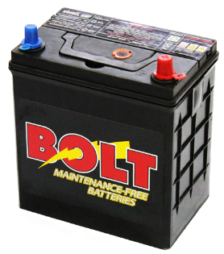
Enhanced Flooded Batteries for Start-Stop:
Pb1200 Series: Formulated for Balanced Performance
Pb1200 Series: Actual Customer Production line Produced 12V testing example
Pb1200 vs Control Battery Performance
Many innovations target improving one aspect of performance, often at the detriment of others.
The Pb1200 Series aims to bring a balanced solution to your battery design, enhancing performance to meet your customers’ requirements without compromising existing qualities.
J537 Cold Charge Acceptance₃
1 - EN 50342-6
2 - EN 50342-1
3 - SAE

Slide 18
Enhanced Flooded Batteries for Start-Stop:
Pb1200 Series: Enhanced Durability
In aggressive, modern cycling tests Pb1200 Series products prevail over control batteries by up to 57%
Represents a synergy of charge acceptance enhancements and material strengthening
Teardown analyses reveal delayed active material shedding, reduced corrosion and decreased sulfation
+57%
+46%
+44%
+68%
+56%
+23%
Notes:
50% -/+,17.5 -, 2185 -/+

Slide 19
Enhanced Flooded Batteries for Start-Stop:
Pb1200 Series: More Consistent Active Material Structure
After >4 Months of intensive PSOC cycling:
  CON plates indicate heavy, hard sulfation of various sizes and arrangements across the plate surface
  Pb1210N decreases sulfate crystal size and frequency to allow the majority of the plate to remain as active sponge lead
  Plates are noticeably stronger to the touch upon teardown; MR strength benefits retained through life
CON Mid-Life
Micrographs at 1000x resolution illustrate Pb1210N’s ability to ensure uniform NAM crystal structure even after > 4 Months of Cycling
Pb1210N Mid-Life
Notes:
Increased plate strength will likely:
Improve battery performance in vibrational tests
Delay battery failure when material shedding is a failure mode
Interconnections of the molecular rebar

Slide 20
Pb1200 EFB: Summary
Pb1200 Series For EFB Enhance:
Charge Acceptance
    EN 50342-6 DCA
    SAE J537 Charge Acceptance
    Nissan 90% SOC Recharge
Deep Discharge performance
Mechanical Durability
CCA & Capacity Consistency
Cycle life as defined by:
  EN 50342-6 17.5% DoD
  EN 50342-6 50% DoD
  EN 50342-6 MHT
  SBA S0101
  VDA Repetitive Over Discharge
  VDA Reserve Capacity Durability
  SAE J2185
  Many OEM and Other Specifications
Formulated products available for:
  Automotive
    Conventional Flooded: Pb1100 Series
    Enhanced Flooded: Pb1200 Series
    Advanced Automotive VRLA: Pb1300 Series
    2-Wheeler Automotive VRLA: Pb1400 Series
  Deep Cycle / Motive
    Flooded for e-Rickshaw: Pb2100 & Pb2200 Series
    VRLA for Mobility Assistance: Pb2300 Series
  Stationary
    Inverter Flooded: Pb3100 Series
    Solar Flooded: Pb3200 Series
    Renewables VRLA: Pb3300 Series

Slide 21

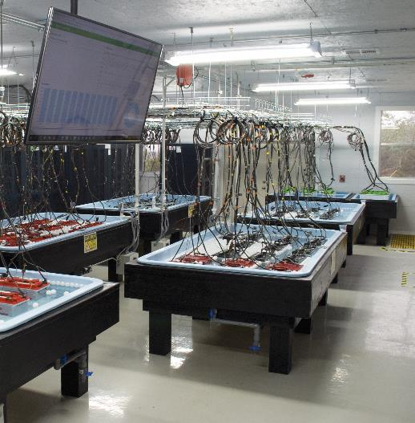
Thank you for your attention!
Visit us at Booth #xx
Our new ISO 9001:2015 Testing Facility!
Special Thanks to Our Partners:
To support our customers:
16ct 300A channels
48ct 100A channels
64ct 25A channels
1ct 1500A HRD unit
Carlos Perez: cperez@bd-structures.com
Regional Sales Manager

