Slide 1

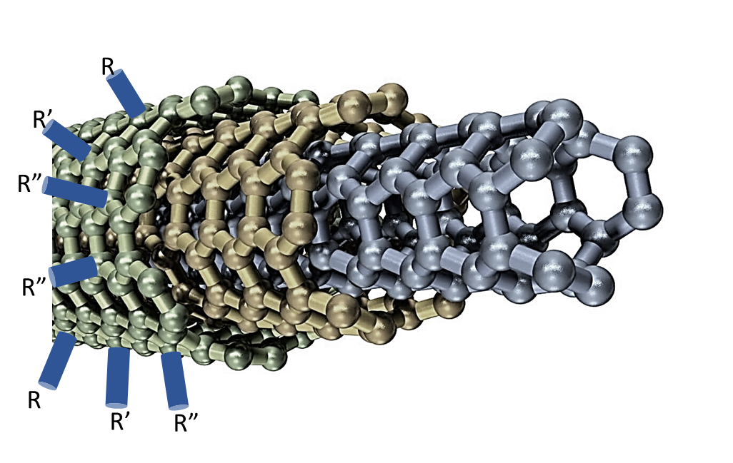

Li1100x
MOLECULAR REBAR® Nano-Solutions for Lithium Ion Battery Anodes
Discrete
About MOLECULAR REBAR®
Designed nano-material with a chemically functionalized surface and conducting core
Discrete and clean nano-material prepared with a patented method (47 Patents granted, 120 pending)
Enhanced connectivity and toughness between active and passive particles and reduced anode swelling/bounce back
Clean
Conductive inner layer
Functionalized outer layer
Application specific formulation
Custom formulation and functionalization provides:
Easy to implement materials requiring no change to existing processes or equipment
Compatibility with SiOx or Si-Alloy systems and CMC/SBR and LiPAA binders components
Reduced Cycle Fatigue ietween particles and reduced bounce back
Use MOLECULAR REBAR nano-solutions to:
Improve energy density by enabling the use of high (5-20%) silicon percentages in aqueous anodes
Enhance cycle life >10-100%
Augment mechanical strength of electrode
Reduce impedance growth
Faster wicking of electrolyte
www.blackdiamond-structures.com
Info@bd-structures.com
+1-512-792-4635
Notes:
NCM523//Anode
Anode Details
20% SiOx + 71% Graphite +1% CMC + 1.5% SBR + 1% C65 + _% XP
Porosity: 25 – 30%
Loading: ~10 mg/cm²
Cathode Loading: 4.2 mAh/cm²
Separator: Glass fiber - Whatmann GF/F
Housing: 40 mAh Single layer Pouch

Slide 2
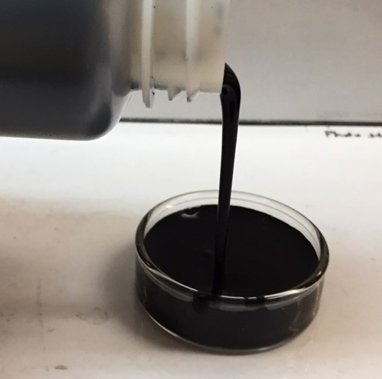
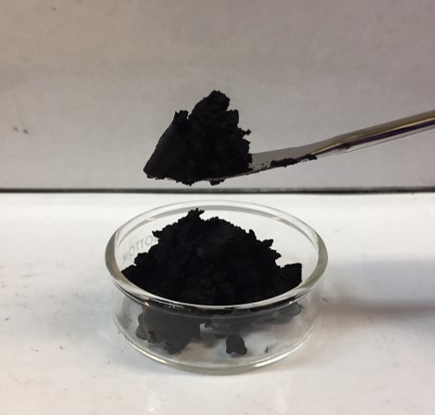
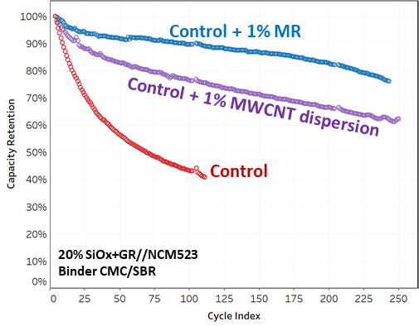
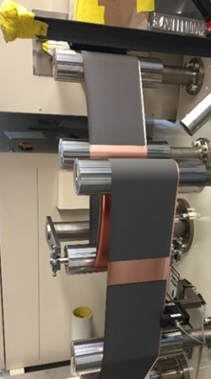
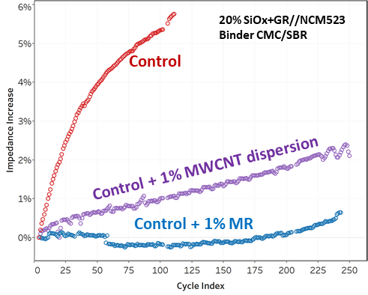
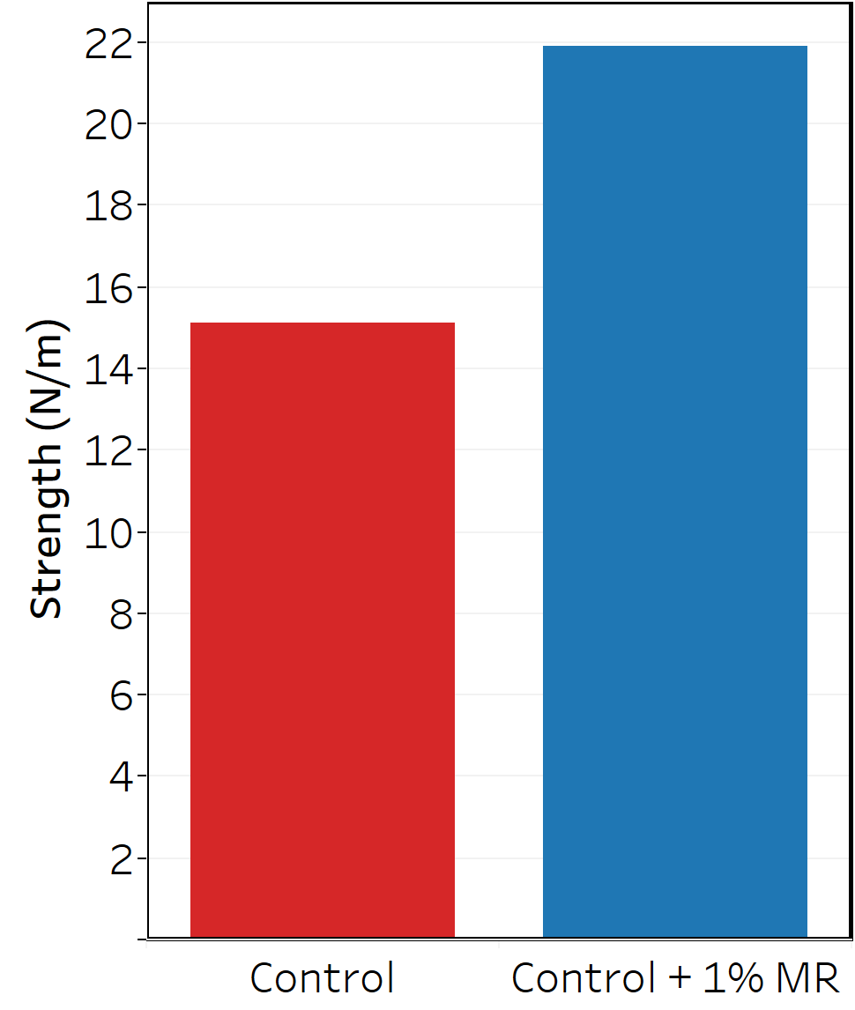
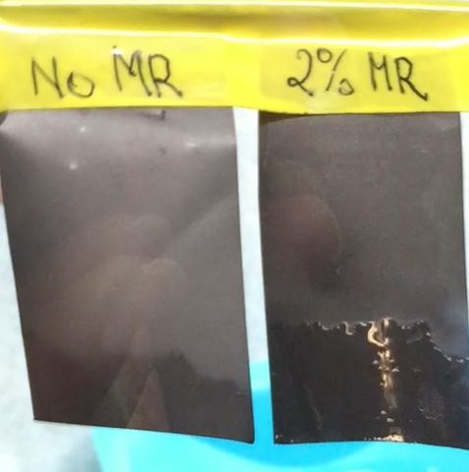

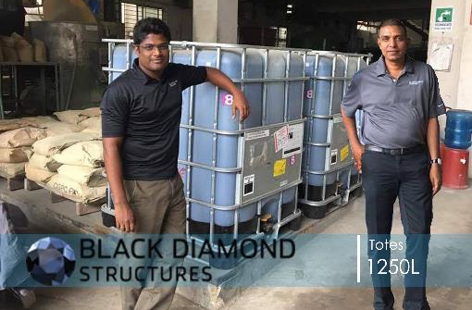
Li1100x
Easy to Implement at Scale with Similar Results to Small-Scale Lab Testing
Longer Cycle Life through Mechanical Improvement and Reduced Impedance Growth
Liquid
Paste
Provided as ready to use liquids or pastes which require no processing prior to incorporation
No change in equipment
Excellent electrode quality
No drag during coating
Reduced bounce back
Better adhesion, strengthened matrix, and slower impedance growth improve performance
MOLECULAR REBAR nano-solutions enable use of anodes with high-content Si and high loading
Improved mechanical properties
Faster electrolyte wicking
www.blackdiamond-structures.com
Info@bd-structures.com
+1-512-792-4635
Notes:
NCM523//Anode
Anode Details
20% SiOx + 71% Graphite +1% CMC + 1.5% SBR + 1% C65 + _% XP
Porosity: 25 – 30%
Loading: ~10 mg/cm²
Cathode Loading: 4.2 mAh/cm²
Separator: Glass fiber - Whatmann GF/F
Housing: 40 mAh Single layer Pouch

